Slide 1
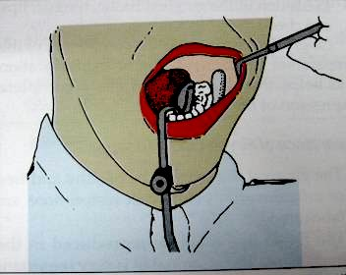
FLUID CONTROL AND SOFT TISSUE MANAGEMENT
RUNGTA COLLEGE OF DENTAL SCIENCES AND RESEARCH
DEPT OF PROSTHODONTICS
PRESENTATED BY DKASHYAP
PRESENTATED BY DR. RUCHA KASHYAP

Slide 2
CONENTS
INTRODUCTION
CLASSIFICATION
ADVANTAGE/ DIS ADVANTAGE
INDIACATION/ CONTRAINDICATION
SELECTION OF ABUTMENT TEETH
TYPES OF ATTCHMENTS
SUMMARY
TAKE HOME MESSAGE
REFERENCES

Slide 3
SPECIFIC LEARNING OBJECTIVES
SR.NO | CORE AREA | DOMAIN | CATEGORY
1. | INTRODUCTION CLASSIFICATION | Cognitive | Must Know
2. | ADVANTAGE/ DIS ADVANTAGE INDIACATION/ CONTRAINDICATION SELECTION OF ABUTMENT TEETH | Cognitive | Must Know
3. | TYPES OF ATTCHMENTS | Affirmative | Must Know

Slide 4
INTRODUCTION
Restorative procedures in the mouth cannot be executed efficiently unless the moisture is controlled . moisture control includes the exclusion of sulcular fluid ,saliva and gingival bleeding from the operating field. It also refers to preventing the aspiration or swallowing of fluid sprayed from the handpiece and restorative debris . primary objectives of moisture control are isolation ,retraction and accessibility.
The gingiva must be displaced to make a complete impression and some time even to permit completion of the preparation and cementation of the restoration.

Slide 5
FLUID CONTROL (ISOLATION)
The need for removal of fluid varies depending upon the task being performed .
Isolation of the operating site is done for the following reasons:
To obtain a dry, clean ,operating field
For easy access and visibility
To improve properties of dental materials
To protect the patient and operator
To improve the operating efficiency

Slide 6
METHOD OF FLUID CONTROL
MECHANICAL
CHEMICAL
OTHER
Rubber dam
High volume vacuum
Saliva ejector
svedopter
Anti-sialogogues
Local anesthetics
Cotton rolls
Cellulose wafers
Throat shields

Slide 7
RUBBER DAM
Introduced by S.C BARNUM in 1864 .
It is the most effective of all isolation devices utilized in restorative dentistry .
valuable in the removal of old restorations or excavation of caries when exposure of the pulp is a possibility .
It is used to define the operating field by isolating one or more teeth from the oral environment.
It eliminates the saliva from the operating side and retracts the soft tissue.
It should not be used while making a polyvinyl siloxane impression, because it will inhibit its polymerization .
It also provides excellent isolation and access when a pin retained amalgam or composite resin core is required before a cast restoration can be fabricated .

Slide 8

parts of rubber dam
Rubber dam sheet
Rubber dam holder
Rubber dam retainer
Rubber dam punch
Rubber dam retainer forceps
Rubber dam napkin
Certain condition preclude the use of the rubber dam
Teeth that have not erupted sufficiently to receive a retainer
some third molars
extremely malpositioned teeth
Patient suffering from asthma may not tolerate the rubber dam if breathing through the nose is difficult .

Slide 9
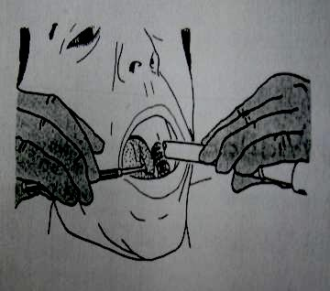
High volume vacuum
A high –volume suction tip is extremely useful during the preparation phase and is most effectively utilized with an assistant
It makes an excellent lip retractor while the operator uses a mirror to retract and protect the tongue .
Mcwherter (1957) showed that one type of evacuator would remove 0.5 L water in 2 seconds ,had a 75% to 95 % pickup of water in air ,and would remove 100 % of solid during cutting procedure .

Slide 10
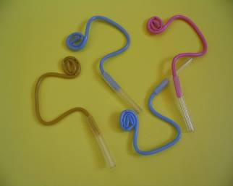
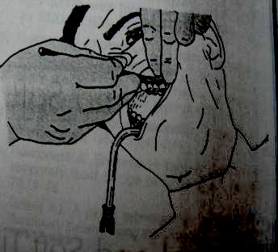
SALIVA EJECTOR
It is most useful as an adjunct to high volume evacuation .
It can be used for evacuation when the maxillary arch is being treated .
It is not very effective during impression and cementation .
It is placed at the corner of the mouth, opposite to the quadrant being operated and the patient ‘s head is turned toward it.

Slide 11
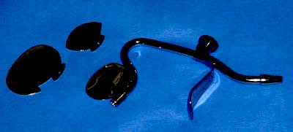
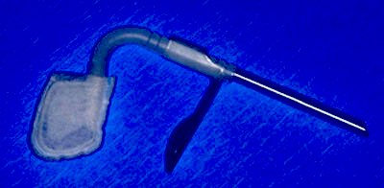
SVEDOPTER
It is used for isolating the mandibular teeth .
It is the metal saliva ejector attached with a tongue deflector .
Disadvantages of svedopter
Access to the lingual surface of mandibular teeth is limited
Since it is a metallic device , care must be taken to avoid any injury to the floor of the mouth .
Presences of mandibular tori precludes its use .

Slide 12
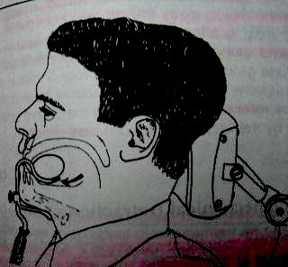
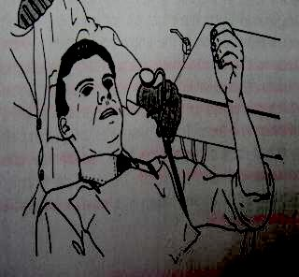
The svedopter is most effective when it is used with the patient in a nearly upright position .In this position ,water and other fluid collect on the floor of the mouth ,where they are pulled off by the vacuum.
PRECAUTION
Selection of an oversized reflector should be avoided. Since it could cut into the palate above or trigger the gag reflex .
For better positioning ,the anterior part of the svedopter should be placed in the incisor region with the tubing under the patient ,arm .

Slide 13
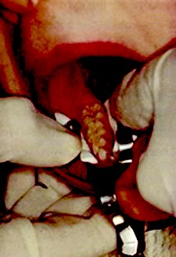
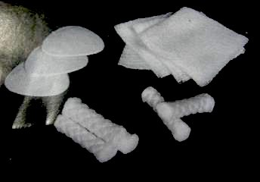
Cotton roll and cellulose wafers
These are helpful for short period of Isolation .Especially in conjunction with profound anesthesia ,absorbents provide acceptable dryness for procedures such as impression –taking and cementation .
Now a days cotton roll holder are used for holding cotton roll in position .But this is inconvenient and time-consuming .
Advantage of cotton roll holders is that the cheeks and tongue are slightly retracted from the teeth, which enhances access and visibility .
when removing cotton rolls or cellulose wafers, it may be necessary to moisten them using the air/water syringe to prevent inadvertent removal of the epithelium from cheek ,floor of the mouth ,or lips .
.

Slide 14
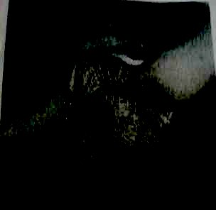
THROAT SHIELD
Throat shield are used during try-in and removal of indirect restorations.
This is particularly important when treating teeth in the maxillary arch .
A gauze sponge (2x2 inch ) ,unfolded and spread over the tongue and the posterior part of the mouth , is helpful in recovering a restoration should it be dropped .

Slide 15
CHEMICAL METHOD
ANTI-SIALOGOGUES
They are gastrointestinal anti-cholinergic that act on the smooth muscles of gastrointestinal ,urinary and biliary tracts , producing a dry mouth as a side effect .
Commonly used anti-sialogogues
Methantheline bromide (banthine) :50 mg 1 hr before procedure
Propantheline bromide : 15 mg 1 hr before procedure
Clonidine hydrochloride (antihypertensive) : 0.2 mg 1 hr before procedure .

Slide 16
Contraindication
History of hypersensitivity to the drugs
Obstructive conditions of the GIT or urinary tract
Patient with glaucoma
Asthma
Congestive heart failure .
side effect
Drowsiness
Blurred vision
Bitter taste
Propantheline can be made tasteless by injecting 2 to 6 mg in solution intraorally .Onset of action occurs in 5 to 10 minutes , and the duration of a dry working environment is approximately 2 hours

Slide 17
Importance of finish line exposure
The gingival tissue must be healthy and free of inflammation before restoration are fabricated
The finish line must be reproduced in the impression . The marginal fit is very important in preventing recurrent caries and gingival inflammation .(marginal integrity)
Obtaining a complete impression is complicated when some or all of the preparation finish line lies at or apical to the crest of the free gingiva .
Control of fluid in the sulcus , particularly when a hydrophobic impression material is used ,is also necessary , because liquids can cause an incomplete impression of the critical finish line area .

Slide 18
Need for gingival retraction
To widen the gingival sulcus to provide access for the impression materials to reach the sub-gingival margins and to record accurately the finished margins
Recording the contour beyond the finish line helps to correctly contour the restoration and smoothly blend the margins of the restorations with the unprepared tooth structure.
While cementing a restoration ,it helps in removal of excess cement without injuring the gingival tissue.
In case of sub gingival preparation ,it prevents injury to the crest of the gingiva.

Slide 19
METHODS FOR GINGIVAL RETRACTION
(A) Mechanical method (a) copper bands
(b) retraction cord
(c) Rubber dam
(B) Chemico-mechanical gingival retraction cord
(C) Surgical method (a) rotary curettage
(b) electrosurgery

Slide 20
(A) MECHANICAL METHOD OF RETRACTION
(a) COPPER BAND /TUBE IMPRESSION
Ist describe by john j .Lucca (1959)
It is used to carry the impression materials as well as to displace the gingiva to expose the finish line . impression compound or elastomeric impression materials can be used along with this band .

Slide 21
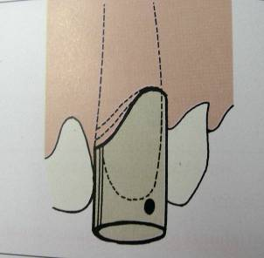
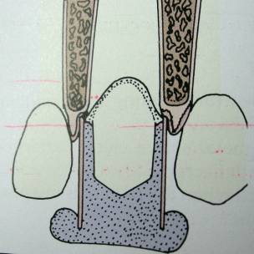
TECHNIQUE
A copper band is welded to form a tube corresponding to the size of the prepared tooth . one end of the tube is festooned ,or trimmed to follow the profile of the finish line. After positioning and contouring the tube over the prepared tooth, it is filled with modelling compound and then it is seated carefully in place along the path of insertion of the tooth preparation and the impression is made .
Disadvantage
It can cause injury to the gingival tissues.

Slide 22
(b) RETRACTION CORD
Plain cotton cord was used for sulcus enlargement physically pushing away the gingiva from the finish line .
Its effectiveness is limited because the use of pressure alone often will not control sulcular hemorrhage .
RUBBER DAM
  Generally it is used when a limited number of teeth in one quadrant are being restored and in situations in which preparations do not have to be extended very far subgingivally .It can be used with modified tray if the bow and wings of the clamp are blocked out .

Slide 23
Chemico mechanical method
CHEMICAL USED
These are generally local vasoconstrictors which produce transient gingival shrinkage.
(A) 8% racemic epinephrine
(B) Aluminium chloride
(C) Alum (aluminium potassium sulphate )
(d) Aluminium sulphate
(E) Ferric sulphate
It is a method of combining a chemical with pressure packing ,which leads to enlargement of the gingival sulcus as well as control of fluids seeping from the sulcus .
gingival retraction cord soaked in a chemical (which promote gingival contraction ) will provide better gingival retraction compared to a plain retraction cord .

Slide 24
Ideal requirement for chemical used with gingival retraction cords
It should produce effective gingival displacement and haemostasis.
It should not produce any irreversible damage to the gingiva .
it should not have any systemic side effect .
contraindications for epinephrine
CVS disease
Diabetes
Hyperthyroidism
Known hypersensitivity to epinephrine
patient taking ganglionic blocker ,or epinephrine potentiating drug
Newer gingival retraction agents are
Phenylephrine hydrochloride 0.25 %
Oxymetazoline hydrochloride 0.05 %
Tetrahydrozoline hydrochloride 0.05 %

Slide 25
Some silent point about epinephrine
The amount of epinephrine absorbed is highly variable ,depending on the degree of exposure of the vascular bed as well as the time of contact and the amount of medication in the cord .
The amount of epinephrine absorbed from 2.5 cm of typical retraction cord during 5 to 15 minutes in the gingival sulcus is 71 µg .It is approximately 1/3 ^{rd} the maximum dose of 0.2 mg (200 µg ) for a healthy adult and nearly twice the recommended amount of 0.04 mg (40 µg ) for a cardiac patient .
If cord is placed around more than one tooth ,if more than one impression is made of a single tooth , and /or if the epinephrine-containing anesthetic is used , a patient could easily exceed the recommended maximum dose of epinephrine .
WEIR and WILLIAMS (1984) ,in an in vivo study of 120 human teeth ,found no significant difference between the hemorrhage control offered by cords impregnated with aluminum sulphate ,and those impregnated with epinephrine

Slide 26
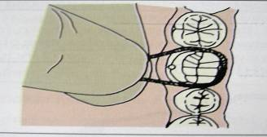
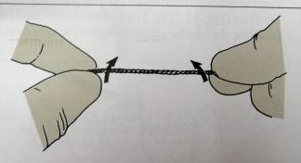
TECHNIQUE
CORD PLACEMENT IS A FINESSE MOVE , NOT A POWER PLAY .
The operating area should be dry. Fluid control should be done with an evacuating device and the quadrant containing the prepared tooth is isolated with cotton rolls.
Hemorrhage can be controlled by using haemostatic agent like hemodent liquid (aluminium chloride)
Retraction cord is looped around the tooth and held tightly with the thumb and forefinger and apply slight tension in an apical direction
Cord is twisted to make it tight and small

Slide 27
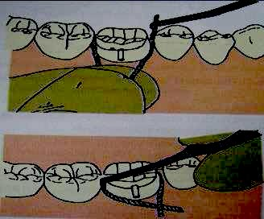
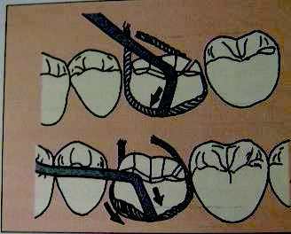
Placement of cord is begun by pushing it into the gingival sulcus on the mesial surface of the tooth .It should be tacked lightly into the distal crevice .
As the cord is being placed subgingivally ,the instrument must be pushed slightly towards the area already tucked into place .If the force of the instrument is directed away from the area previously packed, the cord already packed will be pulled out .

Slide 28
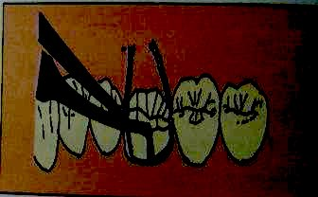
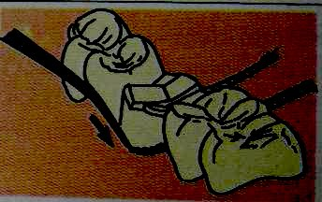
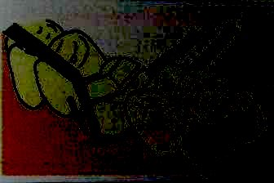
Occasionally it is necessary to hold the cord with one instrument while packing with the second .
The instrument used for packing should be angled slightly towards the root to facilitate the sub-gingival placement of the cord
If it is held parallel to the long axis of the tooth , the cord will be pushed against the wall of the gingival crevice ,and will rebounce .

Slide 29
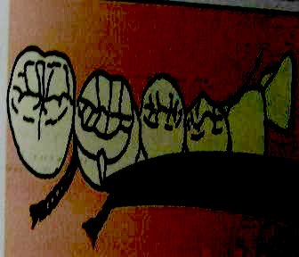
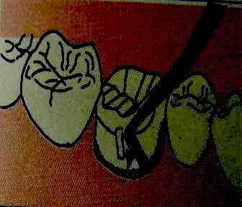
Excess cord is cut off near the inter proximal area such that a slight overlap of the cord occur in this region . if the overlap occur on the facial and lingual surfaces , the gingival finish line in that area may not be replicated properly in the impression .
At least 2-3 mm of cord is left protruding out-side the sulcus so that it can be grasped for easy removal .
After cutting off the excess at the mesial end ,the distal end of the cord is a tucked in until it overlaps the tucked mesial end .

Slide 30
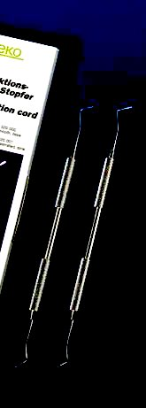
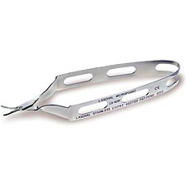
TECHNIQUE (contd)
The cord can be packed with special instrument like Fischer packing instrument .It is a double ended, serrated or smooth edges stainless steel instrument facilitates placing of retraction cord around the tooth.
Both ends of the retraction cord packers are shaped at an angle which allows the cord to be packed swiftly right around the tooth.
.
Retraction cord scissors
Blunt-tipped retraction cord scissors with less risk to tissue. 1/2" long spring steel blades flex for a consistent cut to the tip and a longer service life. Uniband spring handle provides for smooth control.

Slide 31
After 4-6 minutes , the cord should be removed slowly in order to avoid bleeding .If active bleeding persists , a cord soaked in ferric sulphate should be placed in the sulcus and removed after 3 minutes
The impression should be made only after cessation of bleeding .
The retraction cord must be slightly moist before removal . removing dry cord from the crevice can injure the delicate epithelial lining of the gingiva .

Slide 32
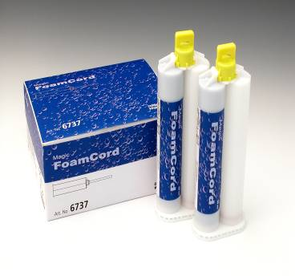
Magic Foam Cord
  Magic Foam Cord is the first expanding VPS material designed for easy and fast retraction of the sulcus without potentially traumatic packing or pressure.

Slide 33
Magic FoamCord
Perfect retraction of the Sulcus, stops bleeding without invasive materials or techniques
Easier to use (same as impression taking). Flows directly into the Sulcus. No need for technique sensitive application technique.
No trauma (no packing or pressure, no bleeding caused by the procedure)
Astringent is not required – no need to rinse
More efficient – when doing multiple preparations

Slide 34
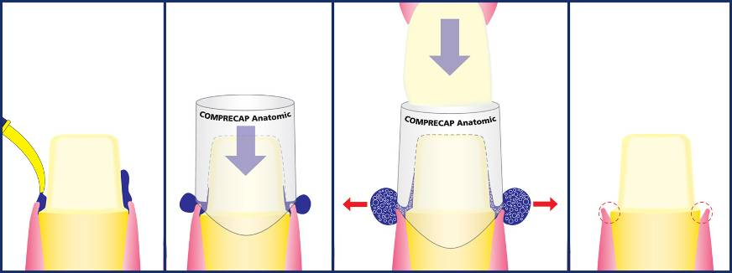
Magic FoamCord
“How Does It Work”
Syringe FoamCord around the preparation
Place pre-fitted Comprecap over tooth and ask patient to bite down
Wait 5 min. to allow FoamCord material to fully set and sulcus to expand
Preparation ready for final impression

Slide 35
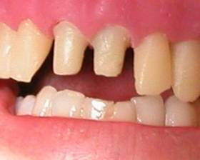
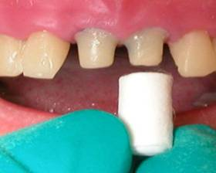
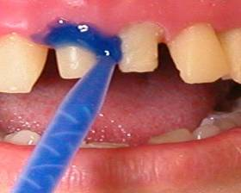
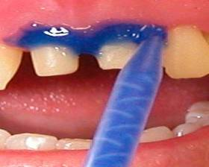
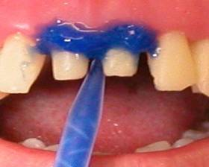
1. Initial Situation
2. Pre-fit the Comprecap
3. Apply Magic FoamCord around the preparations

Slide 36
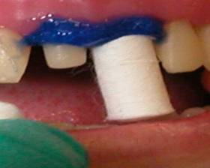
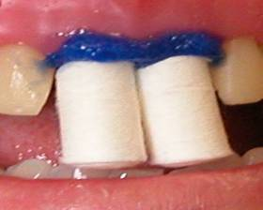
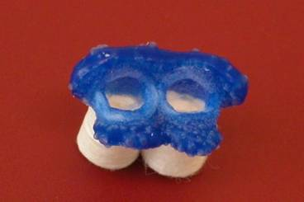
5. Let the patient
bite on the Comprecap
4. Place Comprecap
6. Comprecap After Removal

Slide 37
SURGICAL METHODS
ROTARY CURETTAGE (GINGETTAGE)
It has been compared with periodontal curettage but periodontal curettage is used to debride diseased tissue from the sulcus to allow reepithelization and healing .
kamansky et al (1984 ) reported that less change in gingival height with rotary curettage than with lateral gingival displacement using retraction cord .With curettage there was an apparent disruption of the apical sulcular and attachment epithelium ,resulting in apical repositioning and an increase in sulcus depth .

Slide 38
Rotary curettage (gingettage)
The concept of rotary curettage was described by Amsterdam in 1954 . The technique describe by Hansing.
It is a troughing technique , the purpose of which is to produce limited removal of the epithelial tissue in the sulcus while a chamfer finish line is being created in tooth structure.
It must be done only on healthy , inflammation free tissue to avoid the tissue shrinkage that occur when disease tissue heals .
The following criteria should be fulfilled for gingettage
Absence of bleeding upon probing from the gingiva
The depth of the sulcus is less than 3 mm
Presence of adequate keratinized gingiva .

Slide 39
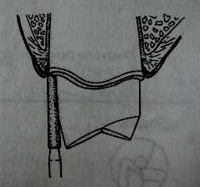
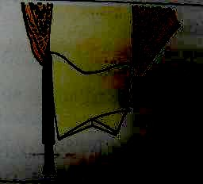
TECHNIQUE
Prior to rotary curettage ,a shoulder finish line is formed at the level of the gingival crest .
A torpedo diamond point simultaneously forms a chamfer finish line and removes the epithelial lining of the sulcus.
Disadvantages
Technique sensitive as the instrument offers poor tactile sensation.
It can potentially damage the periodontium if used incorrectly.

Slide 40
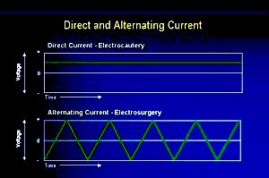
ELECTROSURGICAL RETRACTION
ELECTROCAUTERY Vs ELECTROSURGERY
Often “electrocautery” is used to describe electrosurgery. This is incorrect. Electrocautery refers to direct current (electrons flowing in one direction) whereas electrosurgery uses alternating current. During electrocautery, current does not enter the patient’s body. Only the heated wire comes in contact with tissue. In electrosurgery, the patient is included in the circuit and current enters the patient’s body. In electrosurgery cutting electrode remains cold whereas in electrocautery a hot electrode is applied to the tissue .

Slide 41
Electrosurgery denotes surgical reduction of sulcular epithelium using an electrode to produce gingival retraction .It has been recommended for enlargement of the gingival sulcus and removal of irritated tissue that has proliferated over preparation finish line .
Electrosurgery unit is a high frequency oscillator or radio transmitter that uses either a vacuum tube or a transistor to deliver a high frequency electrical current of at least 1.0 MHZ (one million cycles per second ) . the procedure is also called as surgical diathermy .
Electrosurgery cannot stop bleeding once it starts , if hemorrhage occurs ,it first must be controlled with pressure and / or chemicals , and then vessels can be sealed with a coagulating ball electrode .
Credit for being the direct progenitor of electrosurgery is generally given to D, ARSONVAL (1981)

Slide 42
Contraindication
Patient with cardiac pacemakers because external electromagnetic interference hinders the pacemakers function .
The use of topical anesthetics such as ethyl chloride and other inflammable aerosols should be avoided when electrosurgery is to be used .
Advantages
Sophisticated technique
Can be done in case with gingival inflammation
Produce little to no bleeding .
Quick procedure

Slide 43
Disadvantage
Very technique sensitive
Application of excessive pressure may produce severe tissue damage
Difficult to control lateral dissipation of heat
The operatory area should be very moist during the procedure . this leads to compromised access and visibility .
Mechanism
Current flows from a small cutting electrode that produces a high current density and a rapid temperature rise at its point of contact with the tissue
The cells directly adjacent to the electrode are destroyed by this temperature increases .
The circuit is completed by contact between the patient and a ground electrode that will not generate heat in the tissue because its large surface area produces a low current density , even though the same amount of current passes through it .

Slide 44
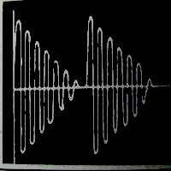
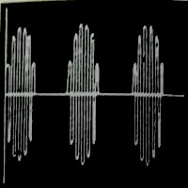
Type of current used for electrosurgery
UNRECTIFIED ,DAMPED CURRENT (OUDIN OR TELSA CURRENT)
It is characterized by recurring peaks of power that rapidly diminishes. It produces intense lack of moisture (dehydration) ,necrosis and coagulation of the cells .It produces slow and painful healing , hence it is avoided .
PARTIALLY RECTIFIED , DAMPED CURRENT (HALF WAVE MODULATED )
Here the current during the second half of each cycle is damped so that only the peak waves act on the electrode .
It produces good coagulation and haemostasis . but it also produces slow and painful healing with considerable tissue destruction because the electrical flow is intermittent .

Slide 45
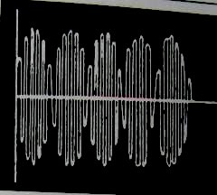
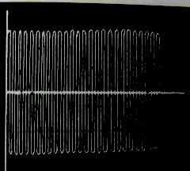
FULLY RECTIFIED CURRENT (FULL WAVE MODULATED )
Here the frequency is similar to a partially rectified current but it is continuous .It produces adequate sulcus enlargement with good cutting characteristics along with good haemostasis .
FULLY RECTIFIED ,FILTERED CURRENT
Here the peak waves are repeated so that there is continuous flow without any dip . lower frequency waves are filtered in this current . it produces excellent cutting . hence it is most preferred .

Slide 46
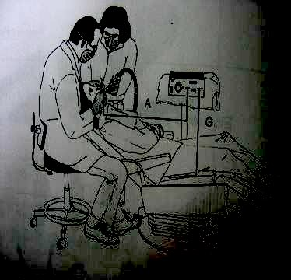
ELECTROSURGICAL UNIT
(A) GROUND ELECTRODE
Also known as ground plate, indifferent plate, indifferent electrode, neutral electrode, dispersive electrode, passive electrode or patient return. Proper grounding of a patient is considered to be the single most important safety factor when electrosurgery is used .
ORINGER recommends that the ground be placed under the thigh rather than behind the back , as is often done . contact with a small bony protuberance , such as a vertebra or bony tubercles could produce a high current density to cause a burn .The only precaution to be observed in placing the ground under the legs is that the patient does not have keys in a pants pocket or is not wearing metal garters .

Slide 47
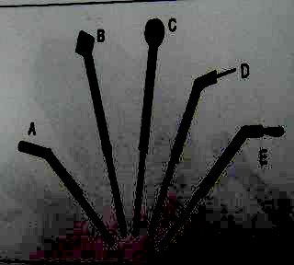
(B) SURGICAL ELECTRODE OR CUTTING ELECTRODE
It is designed to fit on to the hand piece of the electrosurgical unit. This heat helps to vaporize the target tissue. An electrosurgical probe comprises of a shank and a cutting edge. The shank is designed to fit into the piece of the electrosurgical unit. It may be either straight or j- shaped . numerous cutting edge designs are available but the most commonly used ones are
Coagulating probe
Diamond loop
Round loop
Small straight probe
Small loop

Slide 48
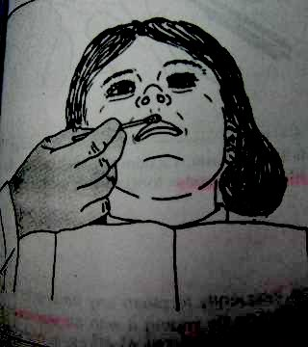
Basic principals during electrosurgical procedures
Local anesthesia should be given.
During electro-surgery, considerable unpleasant odor will be liberated due to tissue necrosis .Aromatic oils such as peppermint oil can be applied at the vermilion border of lip so that it masks the unpleasant odor that will arise from the electrode during the procedure.
Grounding should be done before the usage of the electrode in order to protect the patient from electrical accidents.

Slide 49
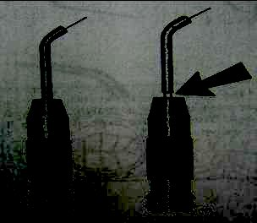
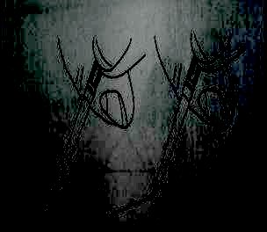
Electrodes must be completely seated in the hand piece . if any uninsulated portion of it other than the cutting tip is exposed outside the handpiece chuck , it could produce an accidental burn on the patient ,s lip .
During its use, the electrode should be applied with very light pressure and swift strikes. Tactile control for the operator is vital for this procedures because it is sufficient to just run the probe along the sulcus without any pressure. Pressure should not be applied, because it may produce excessive tissue damage .

Slide 50
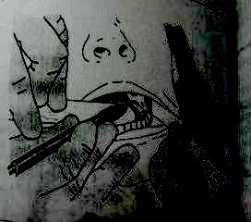
The electrode should never be placed stagnant at any one point as it may lead to lateral dissipation of heat producing gingival injury.
In order to prevent lateral heat dissipation, the probe should be moved at a minimal speed of 7 mm per second.
Moist tissues can be cut best. If it is necessary to redo the cutting in a particular region, a rest period of 8-10 seconds should be allowed to elapse before beginning the second stroke.
The electrode should pass through the tissue in a very smooth motion without dragging or charring the tissue.
A wooden tongue depressor , plastic handle mirror and a plastic vacuum tip should be kept close to the surgical site .

Slide 51
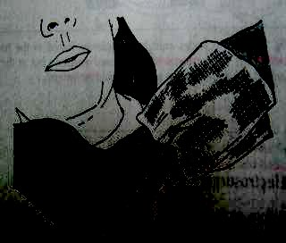
The operator should stop frequently to clean any fragments of tissue from the electrode . the electrode can be cleaned by wiping it with an alcohol –soaked sponge.
Effectively all the basic principles to be followed during electrosurgery can be condensed in to the following triad.
Proper power setting
Quick passage of the electrode
Adequate time intervals between strokes

Slide 52
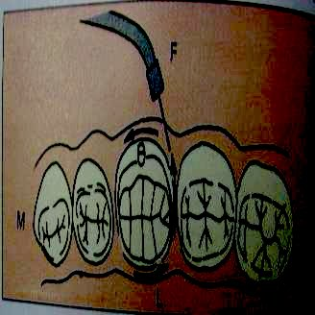
Gingival sulcus enlargement
Before any tissue is removed , it is important to assess the width of the band of attached gingiva .
To enlarge the gingival sulcus for impression making , a small (straight or J shaped ) electrode is selected .
With the electrosurgery unit off , the electrode is held over the tooth to be operated and the cutting strokes are traced over the tissue .
A whole tooth can be covered in four separate motion namely :facial ,mesial ,lingual and distal .

Slide 53
Technique for surgical crown lengthening
Crown lengthening is done when the clinical crown is short in comparison to the anatomical crown .
If there is a wide band of attached gingiva surrounding the tooth, clinical crown lengthening can be done to increase the accessibility. Crown lengthening is nothing but removal of the hyperplastic gingiva (gingivectomy) in order to expose the anatomical crown.
It provides better and more easily maintainable tissue contour.
The diamond electrode is run over the tissues such that one of its surfaces follows the incline of the tooth where the procedure is carried out.
The bevel should be done on attached gingiva to prevent re-growth.
When there is an extensive wound, a periodontal dressing is given (it should be changed weekly).

Slide 54
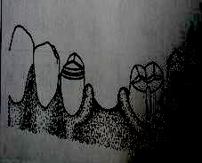
Technique for removal of edentulous cuff
An edentulous cuff is nothing but the remnant of the interdental papilla, which forms a roll of tissue , adjacent to the proximal surface of the teeth , adjacent to the edentulous spaces .
Roll or cuff will make it difficult to fabricate a pontic with cleanable embrasures and strong connectors .So before a pontic is fabricated ,an edentulous ridge should be examined carefully , if there are cuffs they should be removed .
A large loop electrode is used for planing away the large roll of tissue . when this larger electrode is used , it requires a higher power setting of the unit .

Slide 55
summary
Precision attachments serve the function of retention, stress distribution and aesthetics successfully. Appropriate selection of attachments, plays a major role in the success of treatment.
Use of precision attachment strengthens the aspects of retention and particularly, esthetics when compared to conventional removable partial dentures.

Slide 56
TAKE HOME MESSAGE
The clinicians who familiarize himself with precision attachments will add a new dimensions to his treatment options
Proper maintenance and care by the patient and regular follow up decides on the long term success of the attachment and prosthesis.

Slide 57
references
Kanathila H. et al., An insight into various attachments used in prosthodontics: A review, International Journal of Applied Dental Sciences, 2018; 4(4): 157-160
Mensor MC. Classification and selection of attachments. J Prosthet Dent. 1973; 29:494-97
Preiskel H.W. Precision attachments in Prosthodontics: The applications of intracoronal and extracoronal attachments, volume 1, Quintessence books
Preiskel H.W. Precision attachments for partially dentate mouth, Annals of the Royal College of Surgeons of England (I974), vol 55, 294-298

Slide 58
QUESTIONS
1.DESCRIBE THE METHOD TO CONTROL SALIVA AND SOFT TISSUE MANAGEMENT FOR FPD
2.DEFINE GINGIVAL RETRACTION. WHAT ARE THE VARIOUS METHODS OF GINGIVAL RETRACTION FOLLOWED IN FPD WORK.
SHORT ANSWER-
1.TISSUE MANAGEMENT IN FPD
2.RETRACTION CORD
3.FLUID CONTROL

Slide 59
THANK YOU

